Slide 1

Using administrative data to evaluate PCV impacts
against pneumonia
Dan Weinberger, PhD
Assistant Professor
Yale School of Public Health
Epidemiology of Microbial Diseases

Slide 2




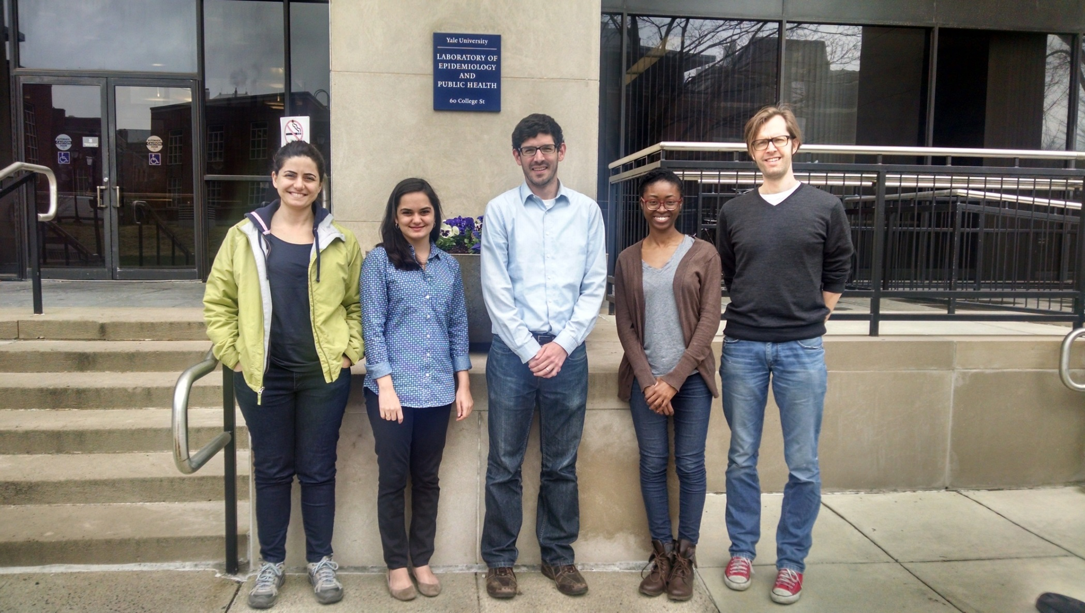



Ecuador
Juan Carlos Arago
Colombia
Hincapie P. Doracelly
Mexico
Lina Sofia Palacio Mejia
Acknowledgments
Brazilian MoH
Roberto Men Fernandes
Chilean MoH
Rodrigo Fuentes
Pamela Burgos
Viviana Sotomayor
Esra Kurum
Christian Bruhn
Josh Warren
Kayoko Shioda
George Washington University
Lone Simonsen (co-Investigator)
Sage Analytica
Cynthia Schuck Paim
Rob Taylor
Roger Lustig
Funding
Lone Simonsen
Josh Warren
Esra Kurum
Christian Bruhn
Cynthia Schuck Paim

Slide 3
Outline
How can administrative data be used to track PCV impact?
Reasons for caution and common biases
Ways to strengthen confidence in estimates of PCV impact and evaluations of existing evidence
USING ADMINISTRATIVE DATA
CAUTION AND BIASES
STRENGTHENING ESTIMATES

Slide 4





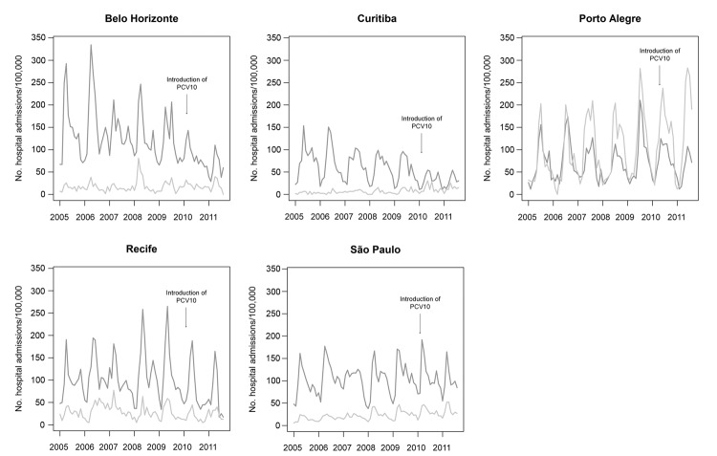
Using administrative data to detect “pneumonia”
ICD-10
Syndromic
case definition
Afonso, et al.

Slide 5
Advantages of administrative data
Ability to rapidly, cheaply collect data on large populations
Can easily stratify analysis into sub-regions
Can readily extract “comparator” diseases to evaluate trends
But…
Often non-specific cases definitions
Need to control for changes in healthcare utilization and other biases
Need to use caution when interpreting and comparing between systems

Slide 6
What does a diagnostic code for ‘pneumonia mean’?
Probably somewhere between ‘clinical pneumonia’ and ‘radiologically-confirmed pneumonia’ in terms of specificity
Ideally would be able to distinguish hospital-acquired pneumonia from community-acquired
First DX code vs later codes
Definitions differ between systems

Slide 7
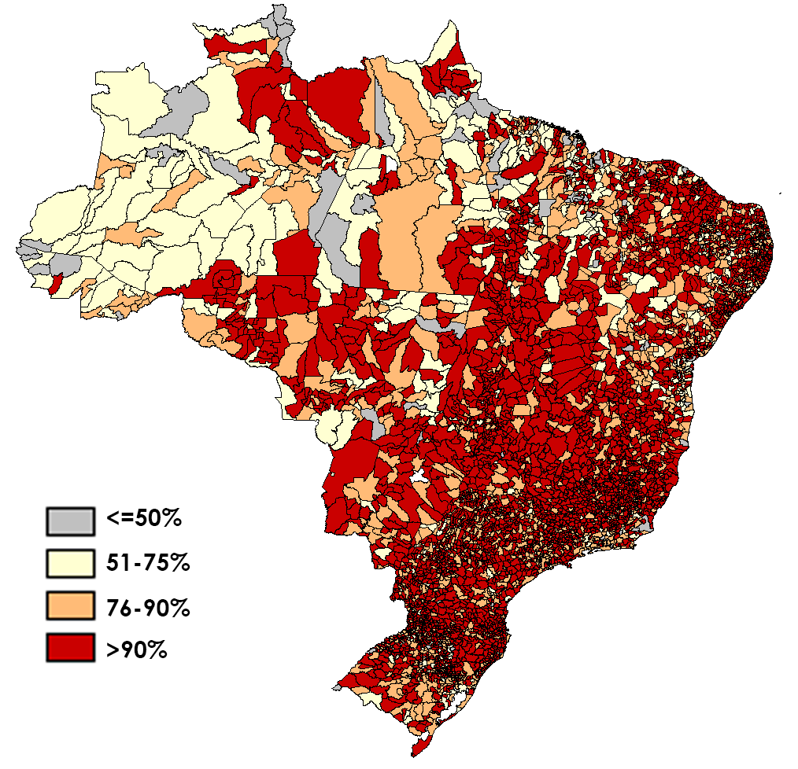
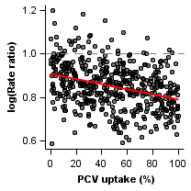
Potential uses of administrative data for evaluating vaccine impact
Time series analysis
Spatiotemporal analysis
Vaccine Introduced
Pneumonia
X% decline
Pre-vaccine
Post-vaccine
Time
Pneumonia rate
Time (months)

Slide 8
USING ADMINISTRATIVE DATA
CAUTION AND BIASES
STRENGTHENING ESTIMATES

Slide 9
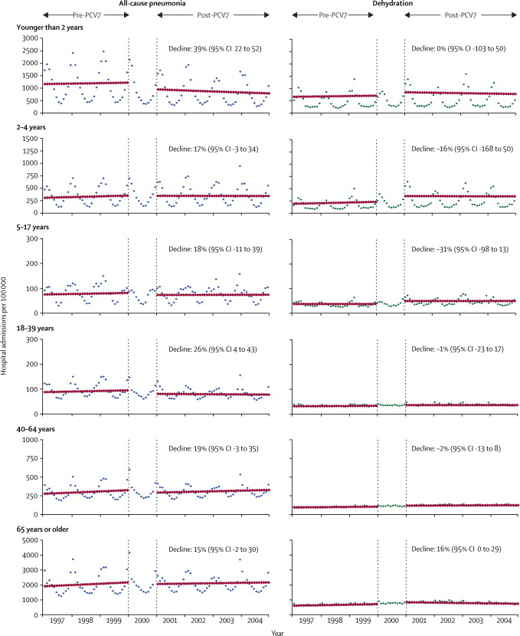
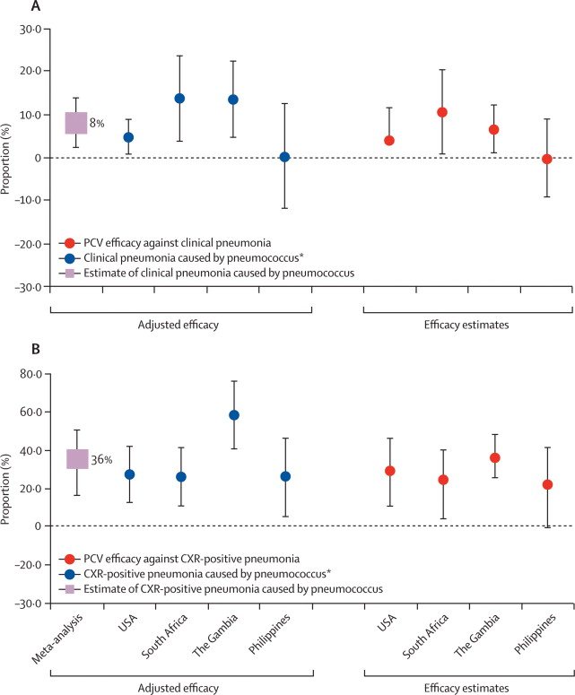
Why should you be skeptical of these types of analyses?
How much can the changes in all-cause pneumonia be attributed to PCV?
Trend studies: Variability; up to 40% declines
RCTs: ~8% Efficacy
Grijalva, The Lancet 2007
(Brazil)
2-23 month olds
-40.3%
Afonso, 2013 EID
O’Brien et al, The Lancet

Slide 10
Interpreting trends in observational studies
Indirect effects in addition to direct effects
Non-vaccine-related trends
Variations in definitions of “all-cause pneumonia”
Societal improvements that reduce pneumonia rates
Changes in healthcare utilization, coding practices
Smaller estimates go unpublished?

Slide 11
Simple pre/post vaccine comparisons to evaluate importance of different potential biases

Slide 12
Effect of denominator on estimates
~70% of Brazilian population uses public healthcare (SUS)
Varies by region and declines over time

Slide 13
Availability of hospital beds

Slide 14
Availability in hospital beds

Slide 15
Effect of improvements in primary care

Slide 16
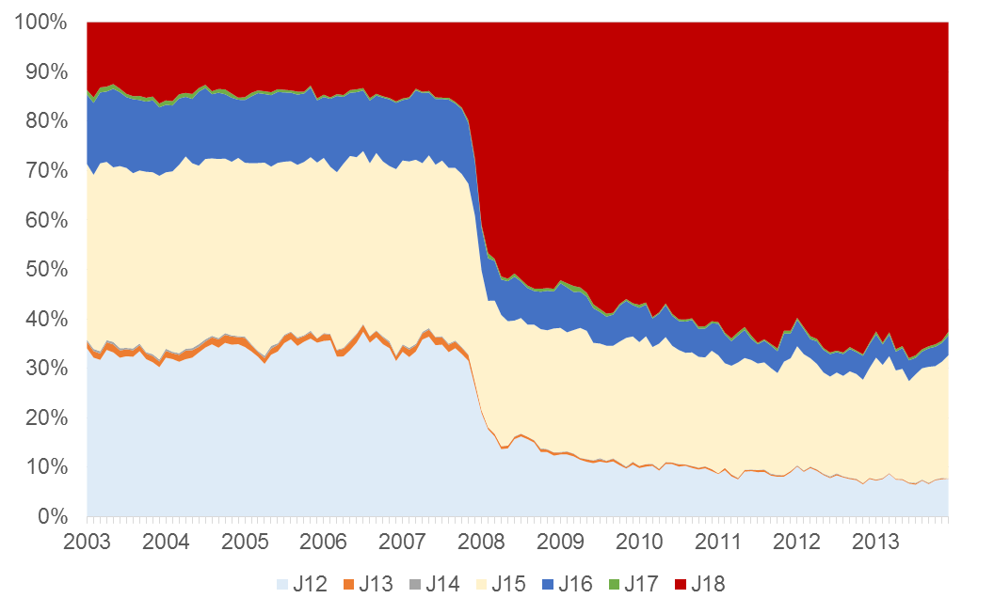
Changes in ICD coding practices
Changes in ICD coding
Pneumonia, unspecified

Slide 17
Reviewing quality of published studies

Slide 18
Summary of data issues
Observed hospitalization rates can be influenced by:
Healthcare access and utilization
Diagnostic coding practices
Hospital capacity
Improvements in living conditions/development

Slide 19
USING ADMINISTRATIVE DATA
CAUTION AND BIASES
STRENGTHENING ESTIMATES

Slide 20
How can we strengthen confidence in estimates from trend studies?
Data issues: denominators, comparators, and power
More robust time series analysis
Use of sub-national data for analysis

Slide 21
Data issues: Denominators
Choose a denominator that reflects changes in potential confounders
Change in all-cause pneumonia 2011-12 vs 2008-09 when using different denominators
 | Total population | Population using public system | All-cause hospitalization
Brazil | .89 | .92 | 0.85

Slide 22
How can we strengthen confidence in estimates from trend studies?
Data issues: denominators, comparators, and power
More robust time series analysis
Change points; Synthetic controls
Use of sub-national data for analysis

Slide 23
Using local administrative data to strengthen our understanding of vaccine impact
>5500 municipalities across Brazil
Variations in speed of vaccine roll-out
Greater decline with higher PCV uptake?
Model many local time series
at once
3+ doses of PCV10 among
12-23 month old children, Brazil (2012)

Slide 24
Using local administrative data to strengthen our understanding of vaccine impact
Rate ratio associated
with PCV10 introduction
Mesoregion(135)

Slide 25
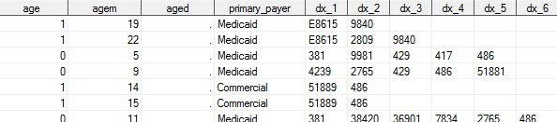
Using administrative data to detect “pneumonia”
Pneumococcal Pneumonia
**All-cause pneumonia**
J12

